Slide 1
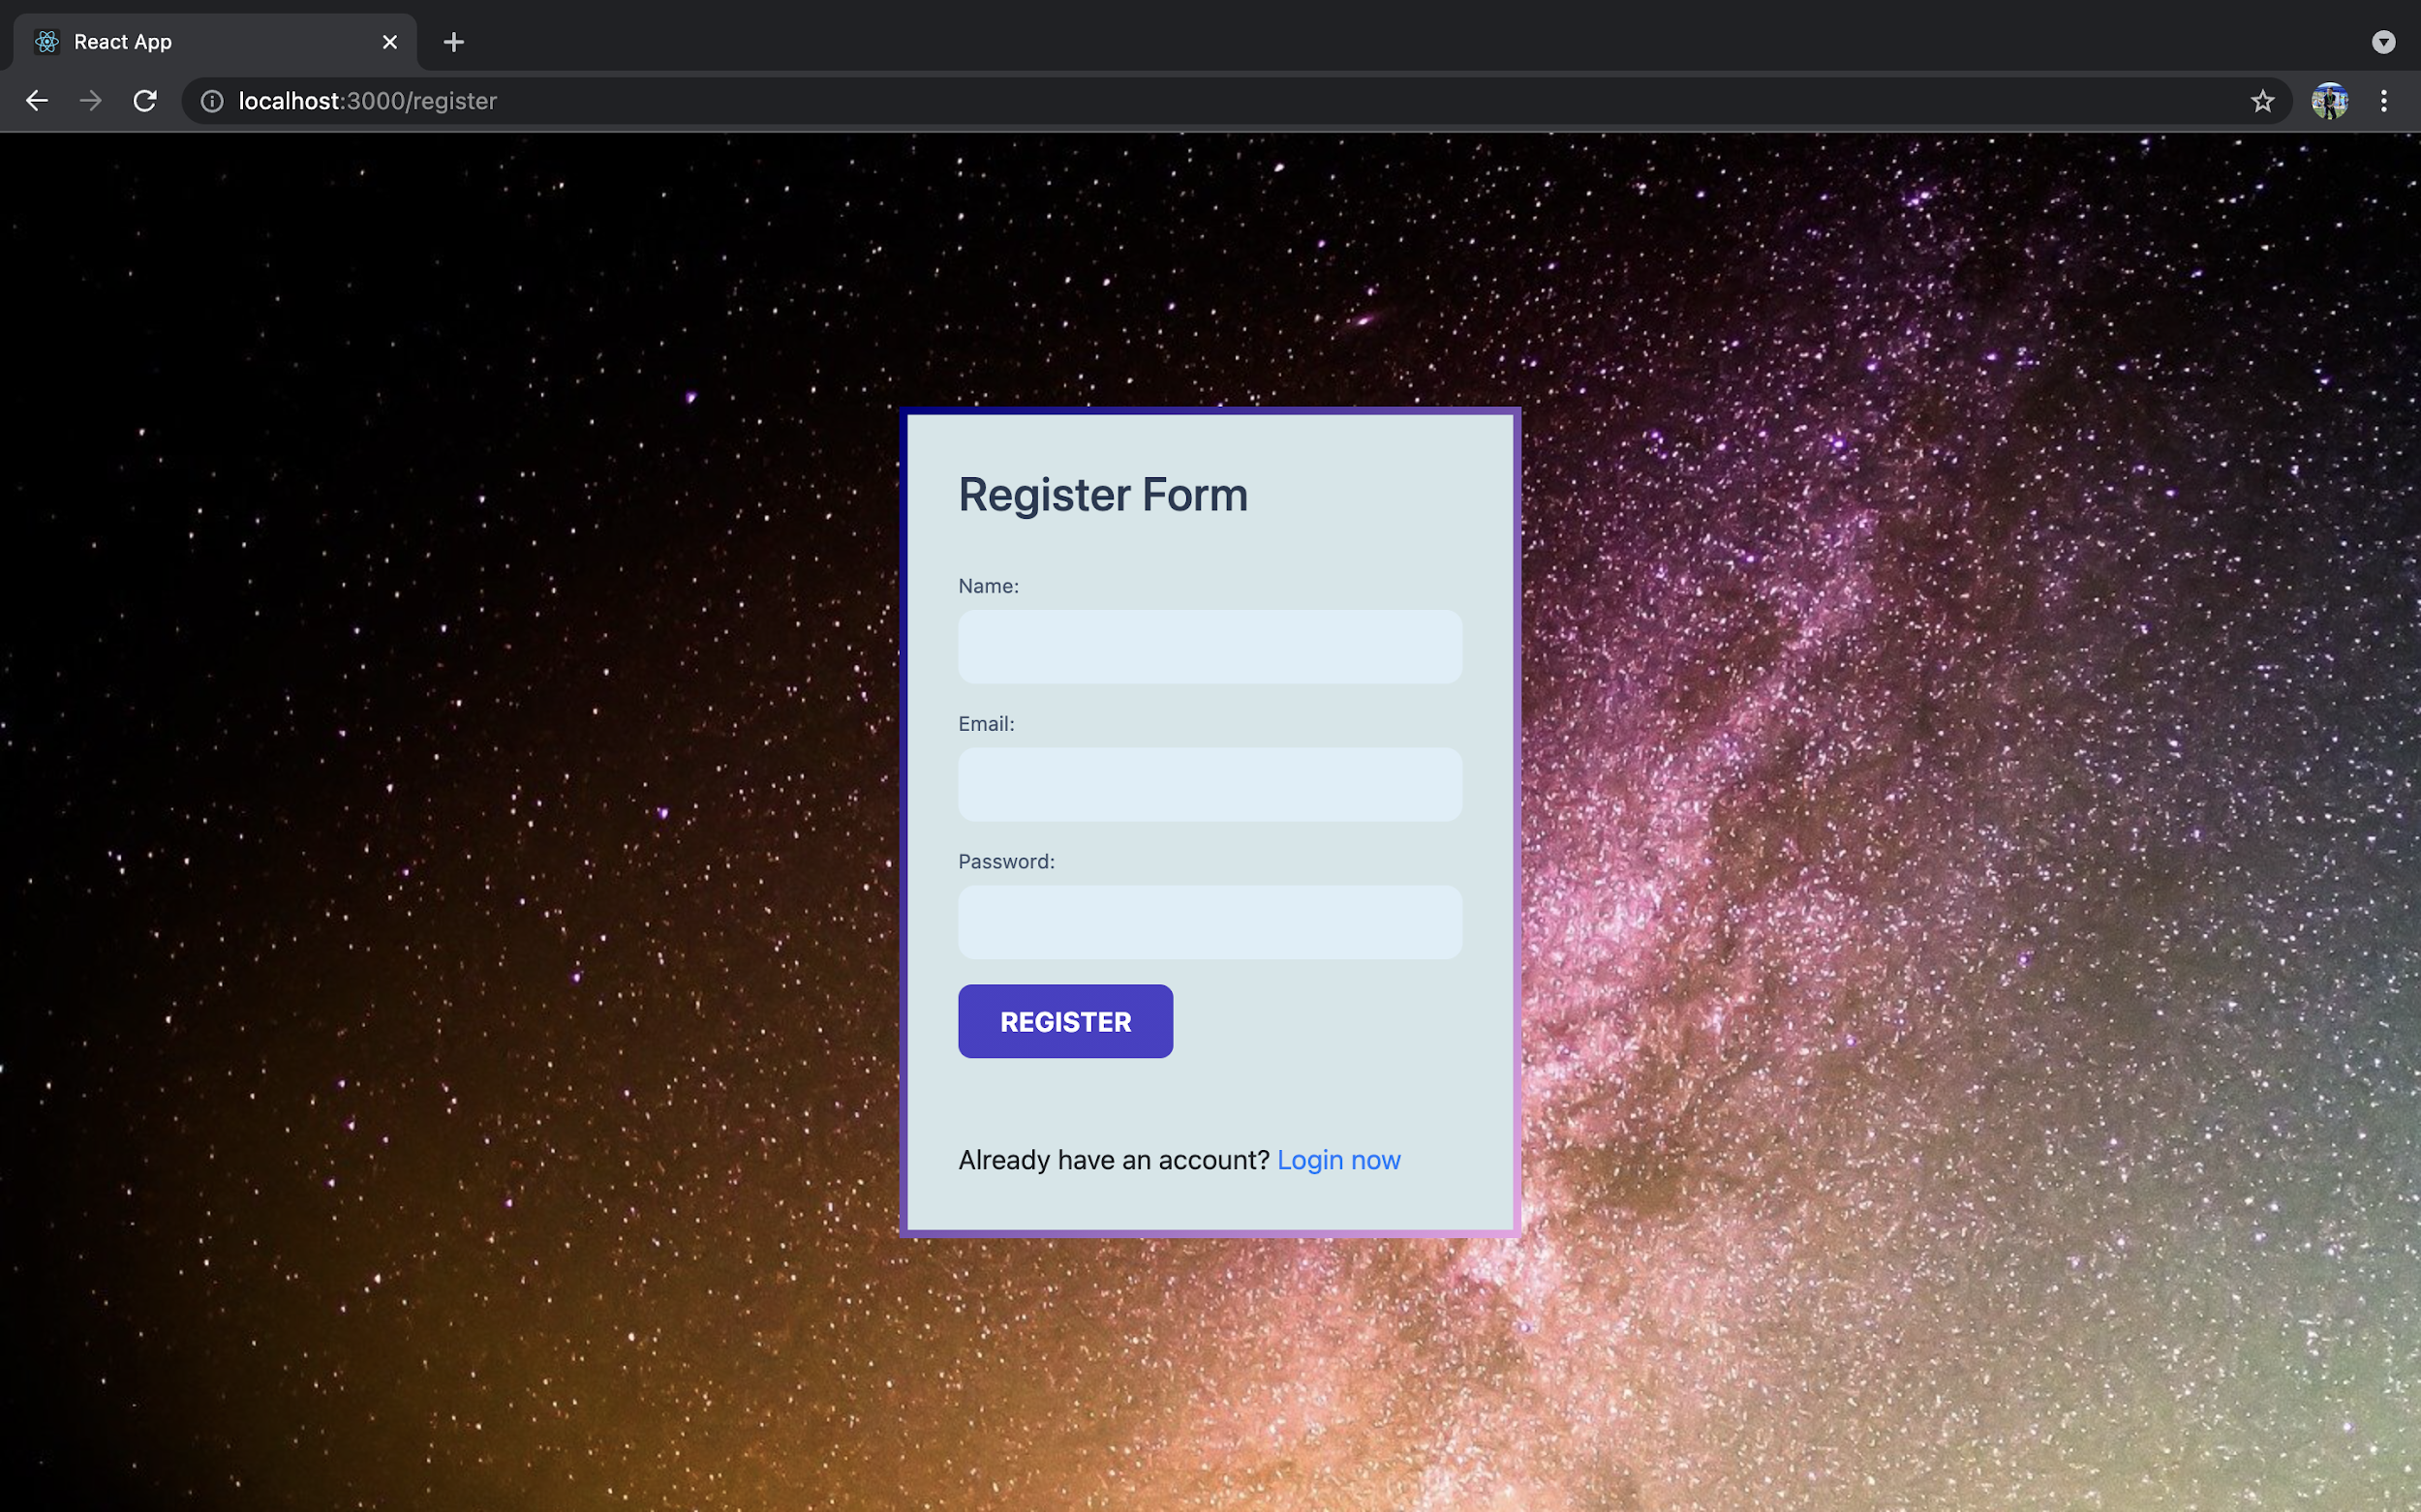
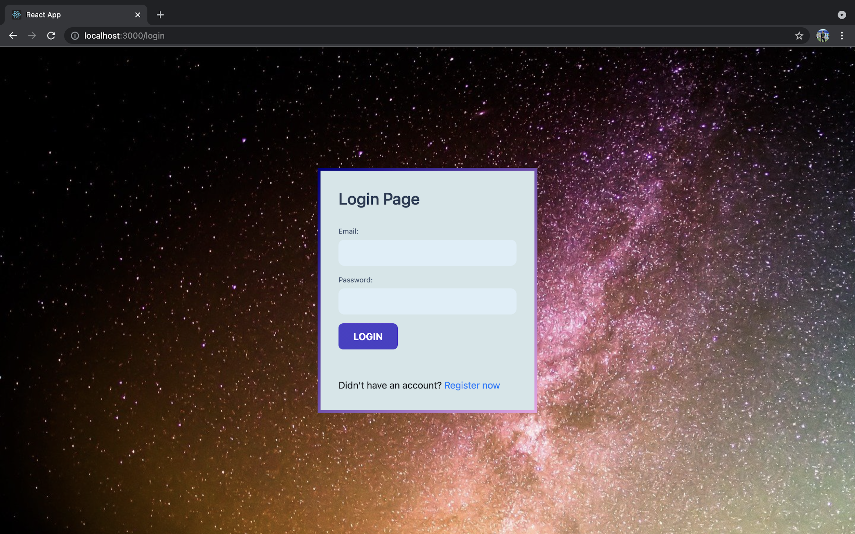
Registration / Login Page
Page for user login
Page for user registration

Slide 2
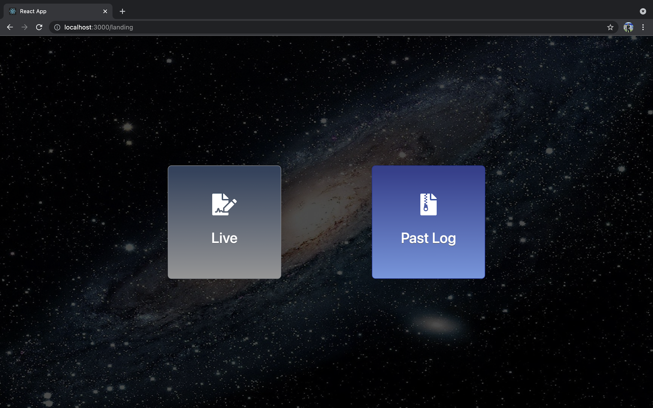
Landing Page (Lobby)
Click here to be redirected next page for past logs room selection
Click here to be redirected next page for live communication room selection

Slide 3
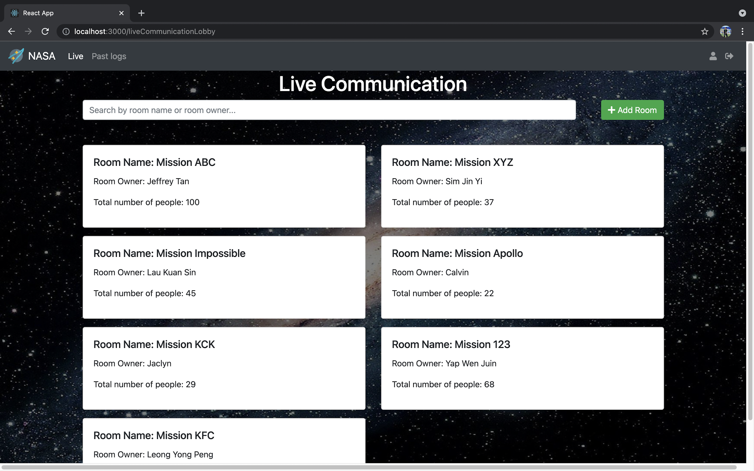
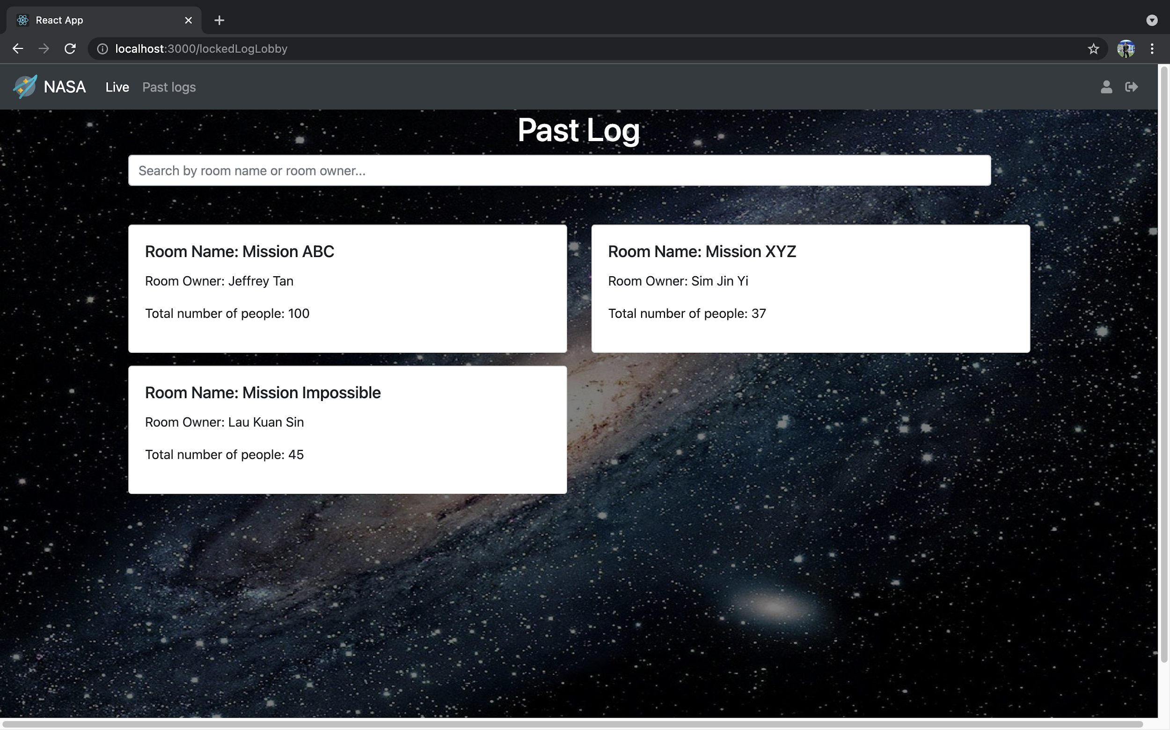
Room Selection
For Live Communication or Past Log
Left icon leads to page of user profiles and right icon is for sign out
Left icon leads to page of user profiles and right icon is for sign out
Rooms available for live communication
Open a new room for live communication
Rooms available for past logs viewing
Rooms available for live communication
Rooms available for past logs viewing

Slide 4
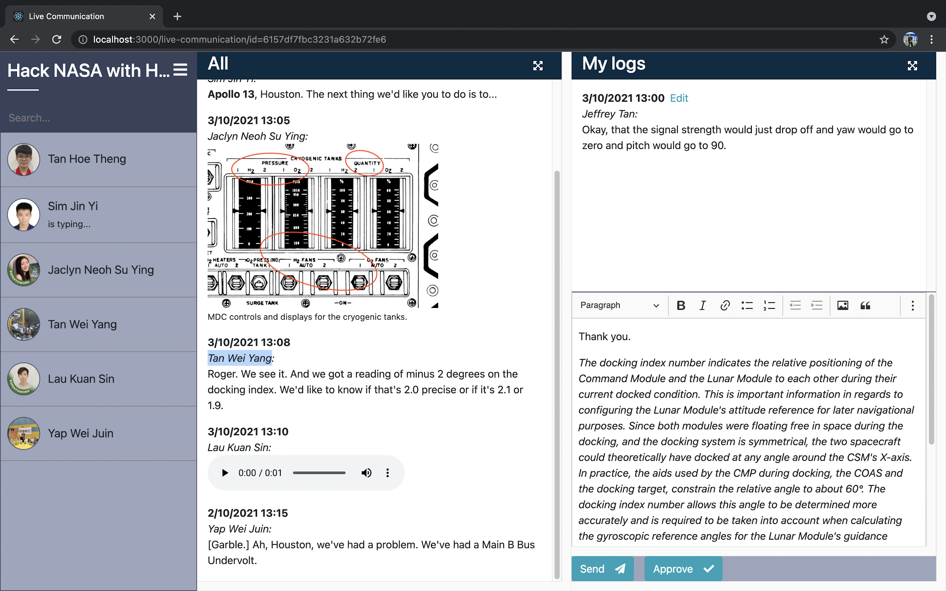
Page of Live Communication
Click here to collapse the user selection menu
Click here to expand
“All” section
Click here to expand
“My logs” section
Search Bar for room participants searching
“My logs” section to view all the console logs published by the users
Area for the user to enter content of console logs to be sent.
Click here to collapse the user selection menu
“All” section to view all the console logs published by all users
Buttons for user to send or “officially approve” own console log

Slide 5
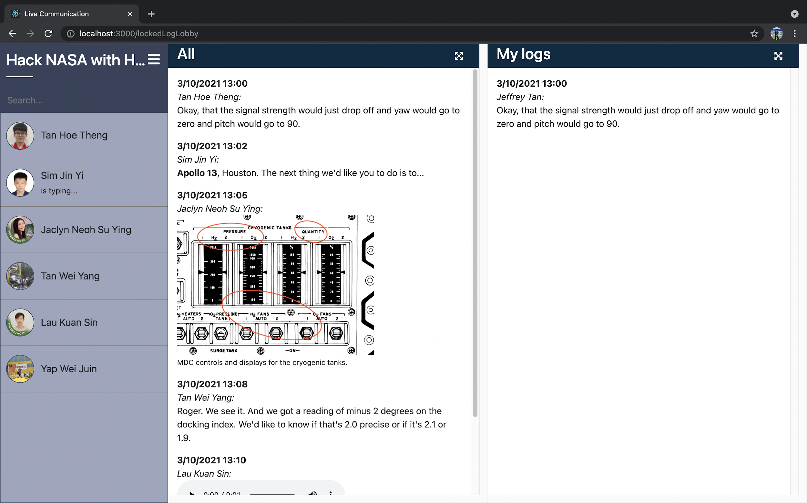
Page of Past Logs
Click here to collapse the user selection menu
Click here to expand
“All” section
Click here to expand
“My logs” section
Search Bar for room participants searching
Click here to collapse the user selection menu
“All” section to view all the console logs “approved” by all users
“My logs” section to view all the console logs “approved” by the users

Slide 6
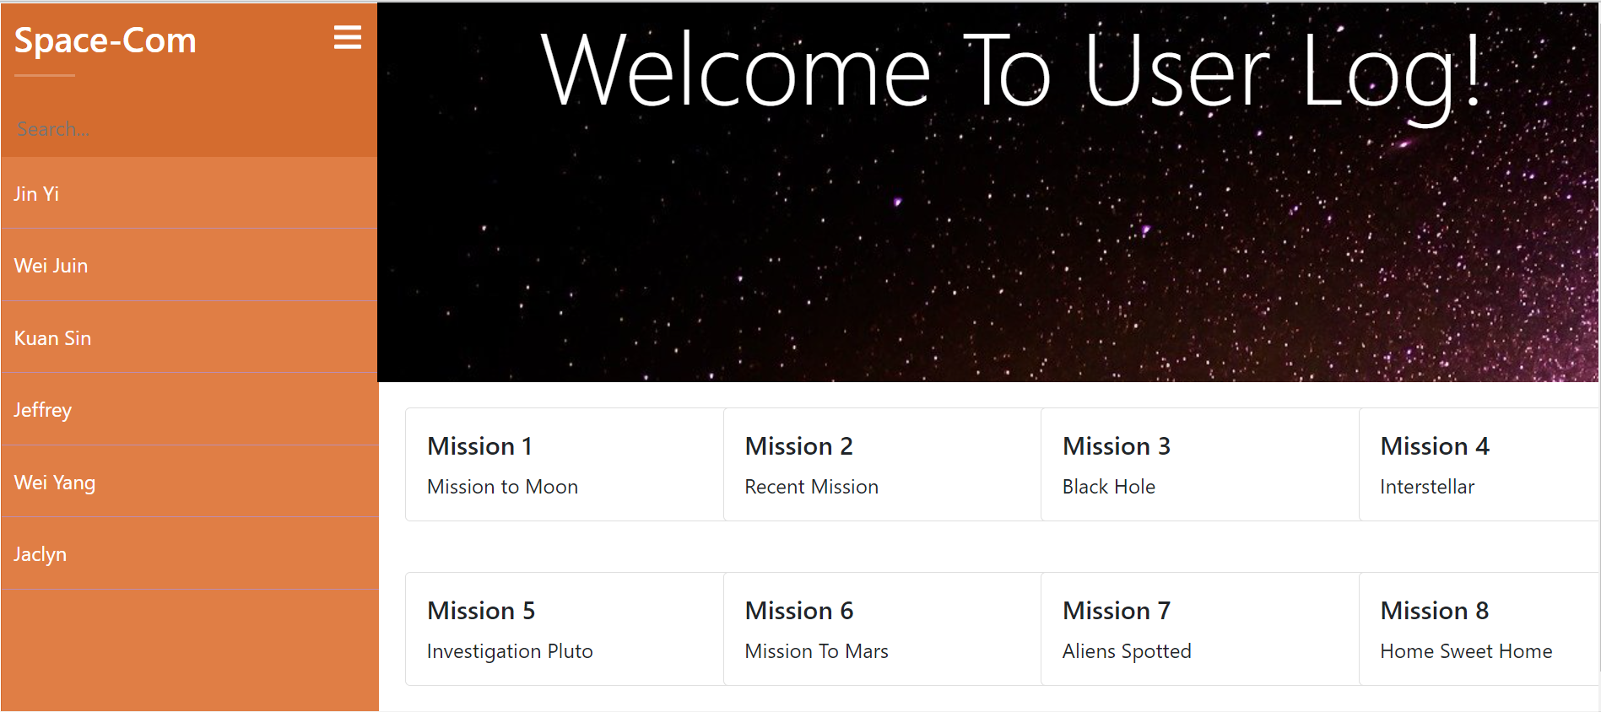
Page of User Profiles
Click here to collapse the user selection menu
Search Bar for room participants searching
Click here to collapse the user selection menu
Click here to collapse the user selection menu

Slide 7
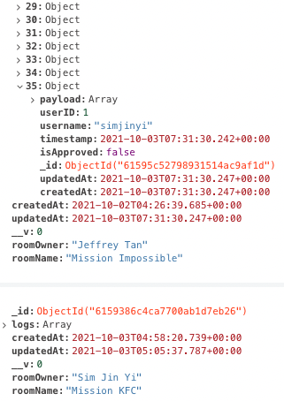
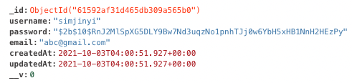
Remote Database
User Data in Database
Console Logs Data in Database

